Slide 1
Encoding and Evolution
Tuan Dong - 01/2024

Slide 2
Agenda
Everything changes
Compatibility
Encoding - Binary encoding
Tools
Q&A

Slide 3
Everything changes
Application change over time:
New products are launched
Features are added or modified (ex: upgrade app on Appstore)
User/business requirements changed (ex: do A/B testing)
New platform replaces old platforms (ex: Microsoft Teams)

Slide 4
Everything changes
Systems need to evolve
So the underlying data schema also changes

Slide 5
Everything change
Suppose, we’re unicorns. Our application has need to:
Support old-version customers without forcing them update
Release a new feature without service downtime
How do you design a system that acquire the requirement?

Slide 6
Everything change
Old and new versions of the code,
Old and new data formats,
may potentially coexist in the system at the same time.
So need to ensure compatibility to not break these mess

Slide 7
Compatibility
Backward compatibility
Newer code can read data that was written by older code.
Forward compatibility
Older code can read data that was written by newer code.
Notes:
Give example of both
Then next section talk about some types of encoding data, and how they handle schema changes and support systems where old and new data and code need to coexist

Slide 8
Encoding
Program work with data in (at least) 2 different representations:
In memory: kept in objects, structs, lists, arrays, hash tables, trees and so on.
Self-contained sequence of bytes (write data to file, send data over network)
=> Need translation between the two
Notes:
In memory: These data structures are optimized for efficient access and manipulation by the CPU (typically using pointers).

Slide 9
Encoding
As everyone known, 2 translation between the two format:
From in-memory to a sequence of bytes: encoding (also known as serialization or marshalling)
The reverse: decoding (parsing, deserialization, unmarshalling)

Slide 10
Encoding - Binary encoding
Textual JSON is the most popular because of human readable, widely adopted, simplicity
So, why we still have binary encoding?
Efficient for data storage (want to minimize storage resource)
Efficient for data transfer (want to reduce time for service communication)
For a small dataset, the gains are negligible. But once we get into the terabytes, the choice of data format can have a big impact.

Slide 11
Encoding - Binary encoding
Given a record
{
"userName": "Martin",
"favoriteNumber": 1337,
"interests": ["daydreaming", "hacking"]
}
Textual JSON takes 81 bytes
We will discover some binary encodings

Slide 12
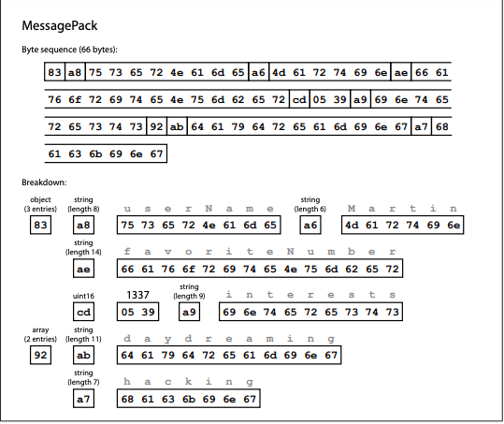
Encoding - Binary encoding
Some binary encodings for JSON
MessagePack
BSON (MongoDB)
BJSON, UBJSON, BISON, …
MessagePack reduces ~19% from 81 bytes to 66 bytes

Slide 13
Encoding - Binary encoding
Thrift and Protocol Buffers
Based on the same principle
Thrift developed by Facebook
Protocol Buffers developed by Google
Both become open source in 2007-08
Both require a schema definition for any data that is encoded (.proto)

Slide 14
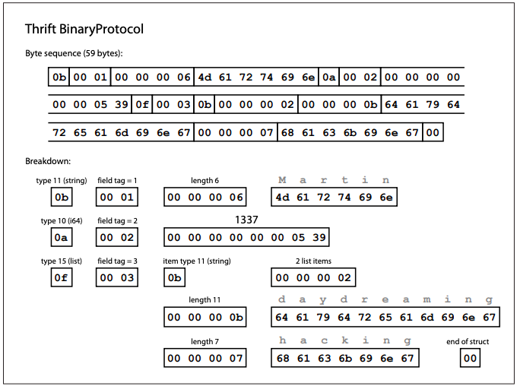
Encoding - Binary encoding
Thrift has 2 different binary encoding formats: BinaryProtocol and CompactProtocol

Slide 15
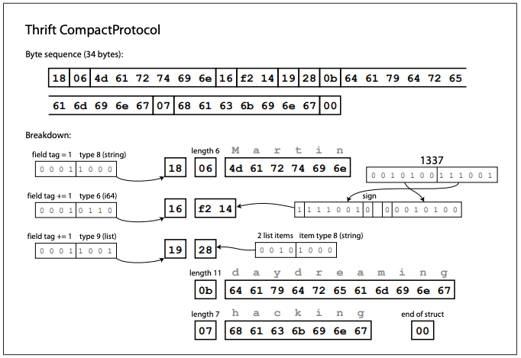
Encoding - Binary encoding
CompactProtocol use less bytes:
Packing the field type and tag number into a single byte
Rather than using a full 8 bytes for the number 1337, it is encoded in two bytes, using the top bit of each byte to indicate whether there are still more bytes to come.

Slide 16
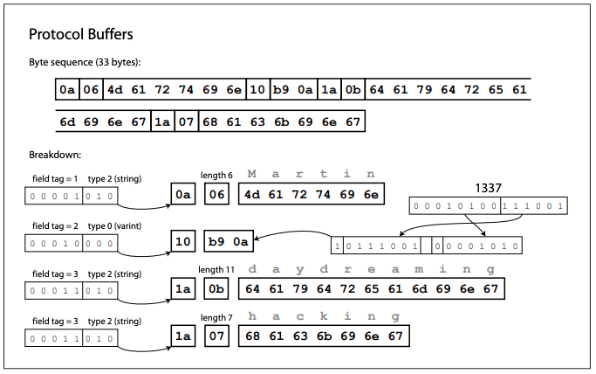
Encoding - Binary Encoding
Protocol Buffers quite similar to Thrift’s CompactProtocol
Both reduces ~60% from 81 bytes to 33 bytes

Slide 17
Encoding - Binary Encoding
How do Thrift and Protocol Buffers handle schema changes while keeping backward and forward compatibility?
Suppose we add a field with a new tag number:
New code writes encoded data into database/file
Old code read the encoded (which doesn’t know about the new tag number)
The parser of old code can simply ignore that field
=> Maintains forward compatibility
Notes:
As you can see from the examples, an encoded record is just the concatenation of its encoded fields.
Each field is identified by its tag number (the numbers 1, 2, 3 in the schemas above), and annotated with a datatype (e.g. string or integer).
If a field value is not set, it is simply omitted from the encoded record.
From this you can see that field tags are critical to the meaning of the encoded data.
You can change the name of a field in the schema, since the encoded data never refers to field names, but you can‐ not change a field’s tag, since that would make all existing encoded data invalid.

Slide 18
Encoding - Binary Encoding
What about backward compatibility?
If we don’t change any tag number, keep the old tag number still the same
The new code can always read data written by old code
Remove a field?
Just like add a field, still backward and forward compatibility
Only remove optional field
Never use the tag number has been removed again

Slide 19
Encoding - Binary Encoding
Change datatype of a field?
Possible, but risk of values lose precision or get truncated.
Ex: change a 32-bit integer into a 64-bit integer
New code can easily read data written by old code, but old code only read 32 bits

Slide 20
Encoding - Binary Encoding
A curious fact of Protocol Buffers:
Not have a list or array data type, but instead a repeated marker for fields
The encoding of a repeated field is just: the same field tag appears multiple times in the record
Nice effect: it’s ok to change an optional (single-valued) field into a repeated (multi-valued) field
New code reading old data sees a list with zero or one elements
Old code reading new data sees only the last element of the list

Slide 21
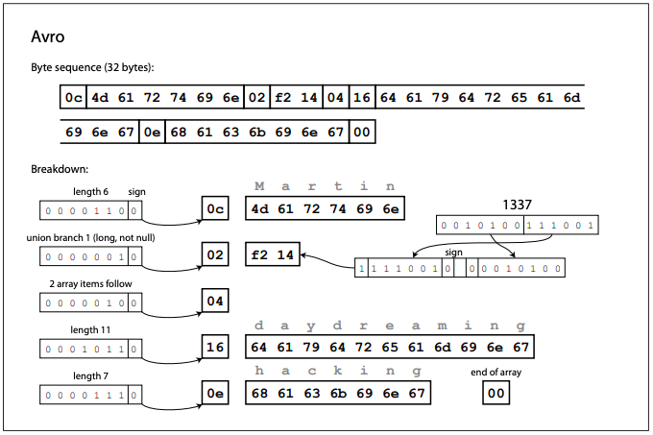
Encoding - Binary Encoding
Arvo is is another binary encoding format that is interestingly different from Protocol Buffers and Thrift.
It was started in 2009 as a sub-project of Hadoop

Slide 22
Tools
Schema Registries in managing schema versions and ensuring data integrity
Kafka is the data storage has multiple-version records
Confluent Kafka has Schema Registry to manage these schemas

Slide 23
Q & A

